Slide 1
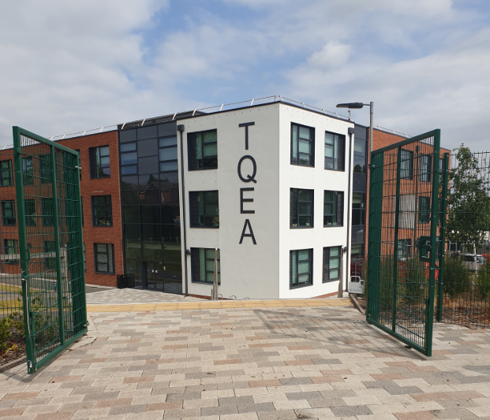
Virtual Tutor Evening
Thursday 9th July 2020

Slide 2
During the meeting we ask that you keep your microphones muted. There will be opportunities at the end for further questions. If you do have an urgent question during the meeting, then simply use the “raise hand” button to signal this. You should see this button on the pop up bar. Otherwise, you can type your question into the chat function.
Use this button to virtually raise your hand.
Use this button to type a question into the chat function.
Use this button to mute your microphone

Slide 3
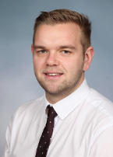
Points of Contact.
Ms Joanna Woodberry
(Tutor)
Mr Jordan Cope
(Head of Year)
Mr Neil Harding
(Principal)
j.woodberry@tqea.org.uk
j.cope@tqea.org.uk
n.harding@tqea.org.uk
Notes:
Change Neil and Donna.

Slide 4
The role of the Form Tutor at TQEA
First point of contact every day
First point of contact every day
Attendance
Communication with parents
Communication with parents
Planners
Uniform and Equipment
High expectations and routines
High expectations and routines
Recognise and celebrate successes
Monitor progress in all subjects
Notes:
Punctuality

Slide 5
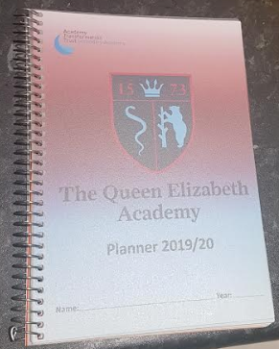
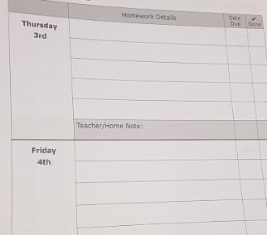
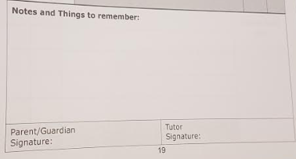
Academy Planner
Home-Academy agreement
Key information
Record homework
Communication
Parent and Tutor signature weekly
Notes:
Punctuality

Slide 6
So what is Tutor Time?
Monday | Thought of the Week / Attendance Checking / Behaviour Monitoring
Tuesday | CHARACTER VALUES
Wednesday | LITERACY
Thursday | LITERACY
Friday | ASSEMBLY
Your opportunity to make sure that you are READY for the week.
These are key days to help you really develop your literacy skills.
In our assemblies we will recap on our learning for the week and celebrate all of our successes.
This is an opportunity to work together to develop our four key character values.

Slide 7
Character Values
Pride Endeavour Resilience Kindness
At TQEA we reward students on four key character values.
Throughout Year 7 you will be tasked with demonstrating these four values both inside and outside of academy. These are the foundations we base our culture and ethos upon.
For each of the character traits that you demonstrate, rewards will be given at various points of the year.

Slide 8
Notes:
Punctuality

Slide 9
My Expectations.
Try your best. | We are all different and no-one can ask any more of you than YOUR best.
Be on time. | Tutor time is an important part of the day so you need to be there, right from the start.
Be kind. | We need to look after each other.
Take responsibility. | You are responsible for you. Don’t blame others. Accept consequences. And be willing to step up and take on responsibilities to help yourself and others.
Good manners! | Say ‘hello’ when we see each other, listen when others are talking, don’t interrupt, please and thank you!
Notes:
Punctuality

Slide 10
My Expectations – morning routine.
Arrive to tutor time on time and with the correct equipment
Enter the classroom in silence and stand behind your allocated chair
Quietly place your equipment for learning on your desk (pencil case, exercise book, student planner, reading book)
At the end of tutor time stand behind your desk and chair in silence
Move quietly and calmly to your next lesson
Be polite and well mannered
Be friendly and kind to all
Make a conscious effort to get along with others
Represent the tutor group in a positive way
Notes:
Punctuality

Slide 11
Uniform.
Our Uniform demonstrates PRIDE in the Academy and the Community
All students without exception must adhere to this uniform policy in every respect.
Uniform checks will be conducted from when students arrive at the academy in the morning, during tutor time and throughout the academy day.
Behaviour Steps will be put in place for uniform infringements
Every child must come to school with a bag and their equipment

Slide 12
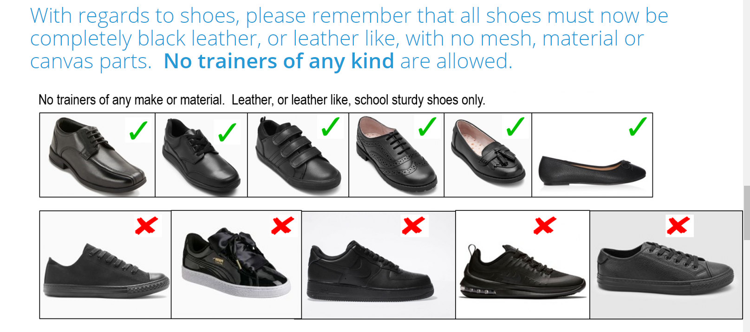
Uniform.

Slide 13
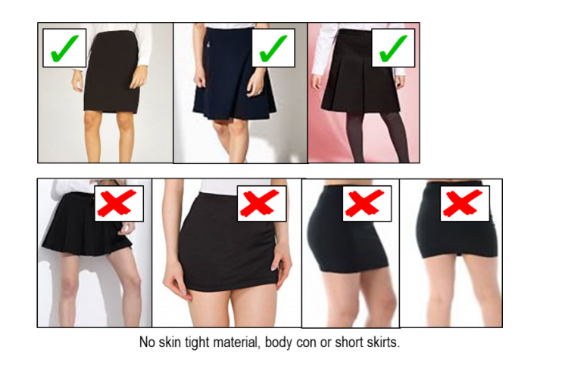
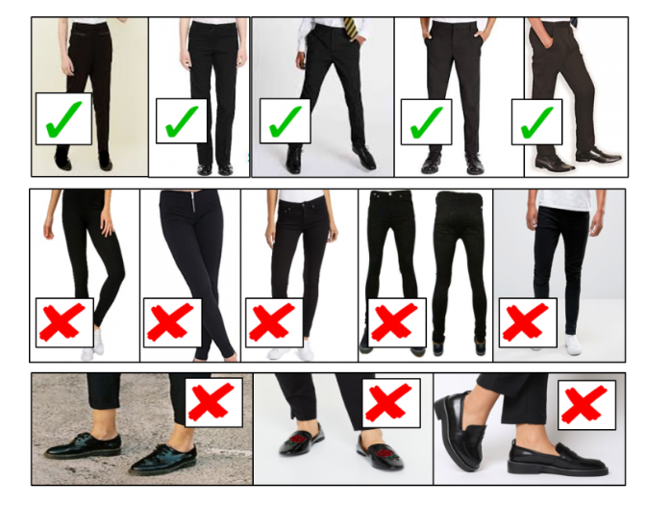
Uniform.

Slide 14
Uniform.
Our uniform policy can be found on the transition section of our website:
https://tqea.attrust.org.uk/academy-life/transition-2020/
This year we will not be holding our annual uniform shop. Instead, uniform needs to be purchased online using the following link:
http://www.yourschoolwear.co.uk/queen-elizabeth-academy-196-c.asp
If you require additional financial support with the purchasing of uniform then please email Mr Cope (j.cope@tqea.org.uk) for further information on how we can help with this. Financial support will need to be requested BEFORE 3.00pm on Friday 10th July.

Slide 15
Equipment.
These will be issued in September.
We also run an equipment shop in school should you require additional equipment throughout the day.

Slide 16
Attendance
- We are following Government guidelines of all pupils in full time from September.
- We are a fining school and will be taking legal action in line with the Government policy on non-attendance from September.
- We will be having a significant rewards structure purely for attendance so that all pupils will be able to have in school experiences and gift card prizes for excellent attendance.
- Parents should contact the school and work with us if there are any significant barriers that are preventing attendance either in the short or longer term.
Our attendance policy can be found on the website using the link below. Any questions on child attendance should be emailed to Mrs Gibson (b.Gibson@tqea.org.uk)
https://tqea.attrust.org.uk/academy-life/transition-2020/

Slide 17
Use of Mobile Phones.
The full Mobile Phone policy can be found on the TQEA website by using the following link:
https://tqea.attrust.org.uk/wp-content/uploads/2020/06/20-Mobile-Phones-Use.pdf

Slide 18
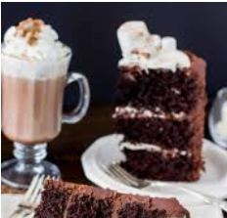
What happens if I do something wrong?
Teacher will always warn students to modify their behaviour for low level behaviours
De-escalation techniques will be used and expectations re-established
Behaviour steps will be applied if necessary
Reflection period may be
required at the end of the
academy day
What happens if I do something well?

Slide 19
Keeping in touch on the Google Classroom.
All students should have now logged on to their TQEA email address and joined the year group and tutor group Google Classrooms. If this is not the case then please mention this at the end of the meeting and I will assist you in doing this.
Throughout the summer, updates will be posted with regards to September. This is also a great platform for the students to remain in contact with each other and develop key relationships before September.
So far, there have been some FANTASTIC achievements, in particular the efforts made in creating the rainbow cakes for DIVERSITY WEEK.

Slide 20
This week’s CHALLENGE.
This week your challenge is to create a poem. This poem needs to be about your local community (this can include school, home, clubs you are part of, anything to do with the area you live in).
Your poem needs to meet the following criteria ...
It needs to have AT LEAST three stanzas (verses)
It needs to rhyme
It should include either alliteration OR a simile
For every poem that is posted onto YOUR FORM GROUP GOOGLE CLASSROOM, Mr Cope will add 5 points to your tally.
Each person can only submit one poem.
Really think about your presentation of these as we want to display as many as possible around the school when you return.

Slide 21
Current LEADER BOARD.
7A2 (Mr Dawkins) have 60 POINTS!
7A1 (Mrs Bott) have 45 POINTS!
7B1 (Mr Packwood) have 40 POINTS! 7B2 (Ms Woodberry) have 35 POINTS!
7A3 (Mr Griggs) have 20 POINTS!

Slide 22
What do I need to do before September?
Sign up to the Year Group and Tutor Group Google Classrooms and complete my This Is Me PowerPoint.
Go onto the TQEA Transition page on the website and watch the videos from staff and the virtual tour of the school.
Make sure I have got all of the correct uniform ready for my first day – especially the correct shoes!
Make sure I have got all of the correct equipment that I need.

Slide 23
Question & Answer.
Are the form groups vertical or horizontal?
In previous years we have had vertical tutor groups that have had students from all year groups. However, we have changed that for the next academic year and all tutor groups will now be horizontal, meaning that students will only be with students from their own year group.
Can children go home for lunch and then return to school?
Students must remain on the school site for break and lunch time. Once students arrive at the school in the morning, the gates to the playground are locked and remain this way until the end of the day to ensure all students are safe.

Slide 24
Question & Answer.
When are Year 7 coming back?
Year 7 will be expected into school on Thursday 3rd September 2020. During the first days back, students will have extended time with their tutors to go over all of the important information that they missed out on from Transition Days.

