Slide 1

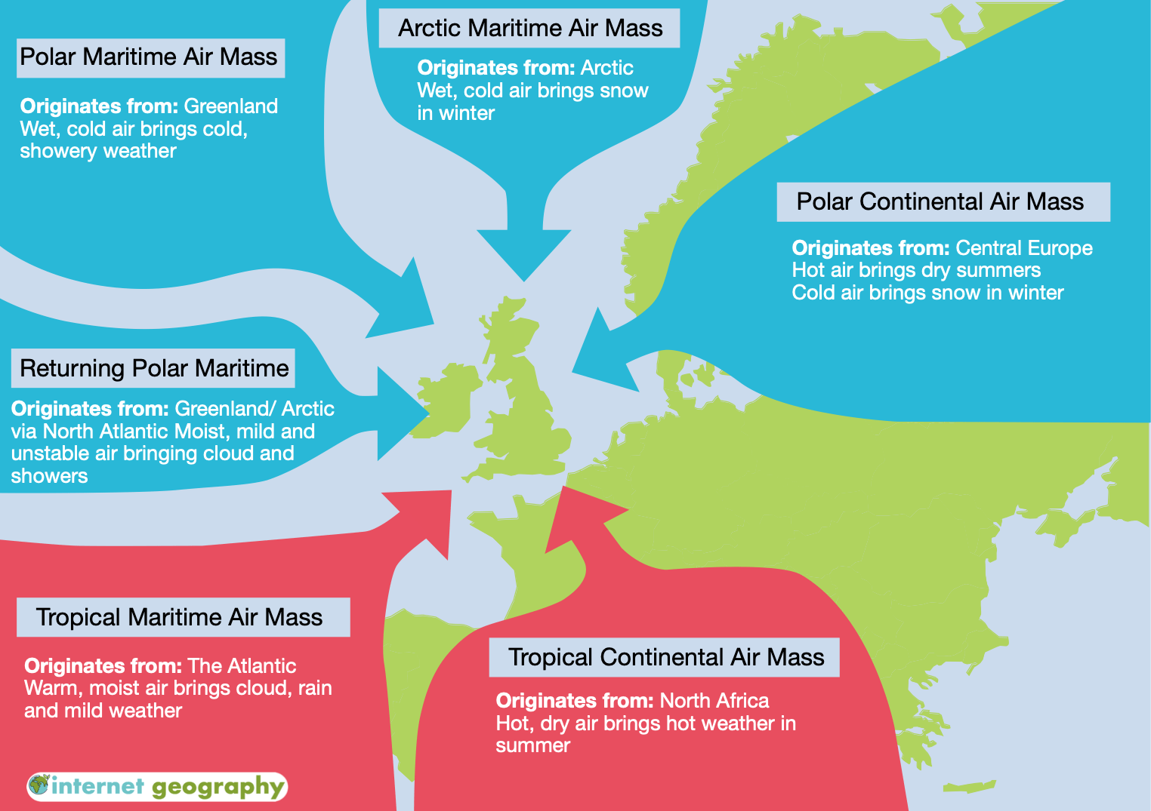
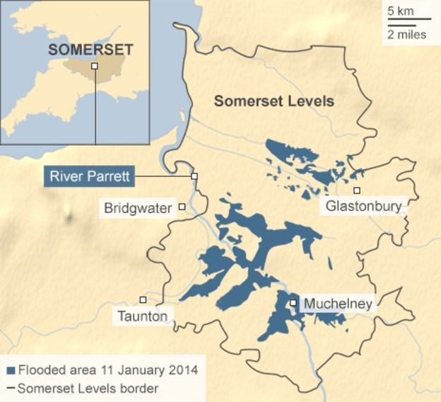
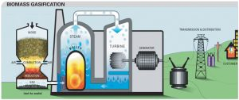
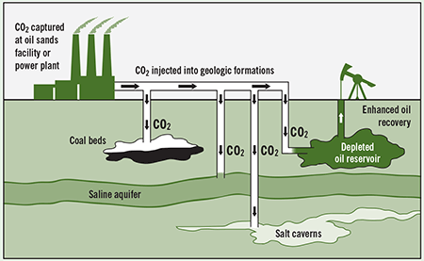
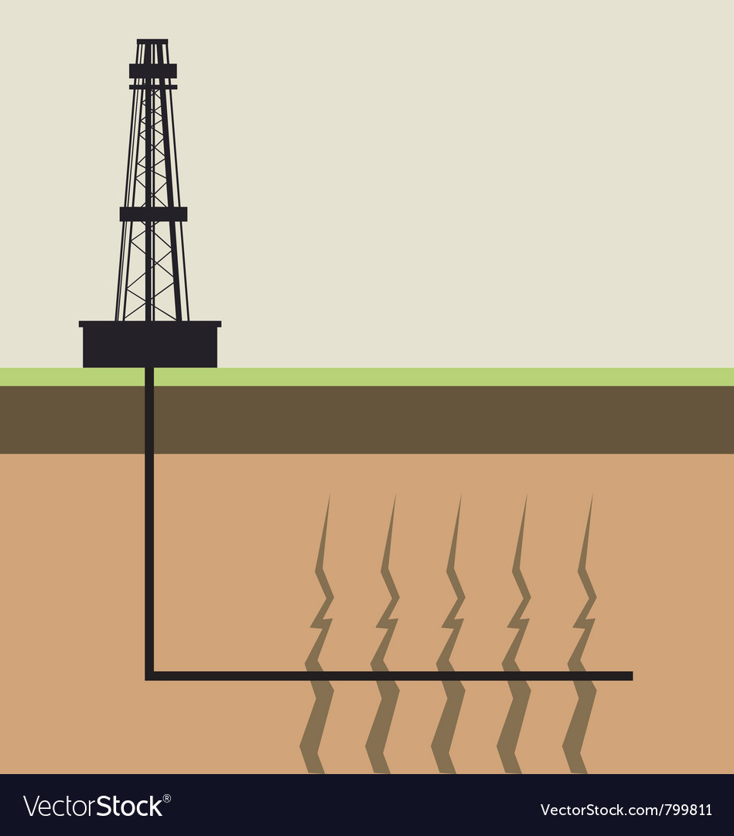
Geography Year 10 Environmental Challenges
Key Context
Key Vocabulary
Key Knowledge
Air Masses
Movements of air from tropical, polar, continental and maritime regions
Prevailing wind
Dominant wind direction travelling towards an area
North Atlantic Drift
Warm ocean current travelling from the Caribbean over the Atlantic
Continentality
Lack of evaporation over continental areas such as Southern Europe and Africa
Jet Stream
Atmospheric belt created by the combination of warn and cold air
Energy Supply
Where our energy comes from at its point of origin
Energy demand
The need for energy around the world.
Non-renewable Energy
Energy that cannot be replenished and therefore will run out
Renewable energy
Energy that can be replenished and therefore will not run out
Fossil fuels
These are produced through the extraction of decomposed pre-historic plants and animals
Biomass
The use of plant and animal waste to produce energy
Hydroelectric Power (HEP)
Power generated from water turbines located near a dam or reservoir
Solar
Renewable energy that uses photovoltaics (PV), to convert sunlight.
Geothermal
The use of heat from within the earth’s mantle to produce energy
Hydraulic fracturing
The secretion of fossil fuels through the excretion of water, sand and chemicals to access molecules of gas and oil.
Nuclear
The fusion OR fission of minerals such as uranium using water molecules to create energy
Sustainable
Meeting the needs of today without compromising the needs of the future
How air masses, the North Atlantic Drift and continentality influence the weather in the UK. • How air masses cause extreme weather conditions in the UK, including extremes of wind, temperature and precipitation.
Case study of one UK flood event caused by extreme weather conditions including: causes of the flood event, including the extreme weather conditions which led to the event effects of the flood event on people and the environment the management of the flood event at a variety of scales
Overview of how environments and ecosystems in the UK are used and modified by humans, including: mechanisation of farming and commercial fishing to provide food wind farms and fracking to provide energy reservoirs and water transfer schemes to provide water
Identification of renewable and non-renewable energy sources. • The contribution of renewable and non-renewable sources to energy supply in the UK.
Changing patterns of energy supply and demand in the UK from 1950 to the present day, and how changes have been influenced by government decision making and international organisations. • Strategies for sustainable use and management of energy at local and UK national scales, including the success of these strategies. • The development of renewable energy in the UK and the impacts on people and the environment. • The extent to which non-renewable energy could and should contribute to the UK’s future energy supply. • Economic, political and environmental factors affecting UK energy supply in the future.
Key Context

