Slide 1

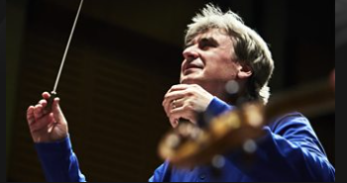
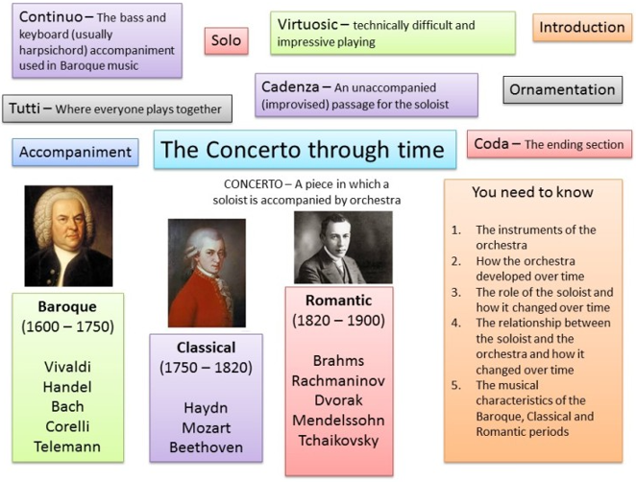
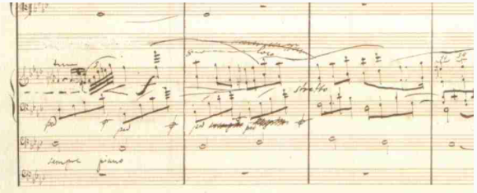
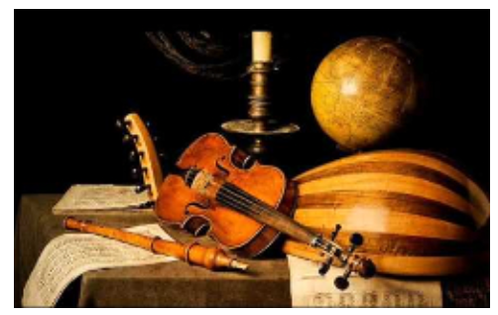
Music Year 10 The Concerto Through Time
Key Skills
Key Knowledge
Appraise
Listen
Perform
Compose
Listening | Appraising | Performance | Composition
I can listen to a piece of music and understand the importance of being respectful to my fellow peers when performing. | I can appraise music using knowledge and understanding from the musical elements. | I can perform musically, fluently and accurately to the class. | I am able to compose a piece of music using musical devices and techniques.

Slide 2
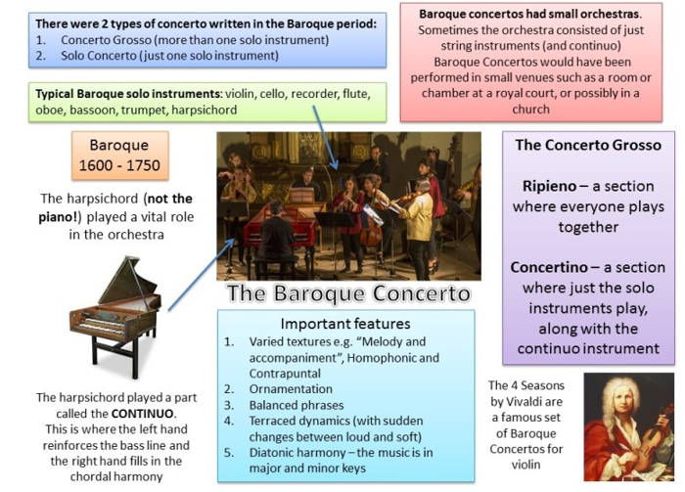
Music Year 11 The Concerto Through Time
Key Vocabulary
Baroque era – 1600 - 1750
Classcal era – 1750 - 1820
Romantic era – 1820 – 1910
Composer – A person who writes music
Ornaments – the embellishment of a melody, either by adding notes or by modifying rhythms
Orchestra – a group of instrumentalists, especially one combining string, woodwind, brass, and percussion sections
Concerto – a musical composition for a solo instrument or instruments accompanied by an orchestra
Concerto Grosso – a musical composition for a group of solo instruments accompanied by an orchestra.
Harpsichord – a keyboard instrument with horizontal strings which run perpendicular to the keyboard in a long tapering case, and are plucked by points of quill, leather, or plastic operated by depressing the keys
Ripieno – accompanying the concertino in baroque concerto music
Concertini – a solo instrument or solo instruments playing with an orchestra.
Continuo - continuo is an accompanying part used in Baroque music, which provides a bassline for the other parts and adds harmony

