Slide 1

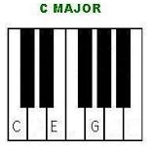
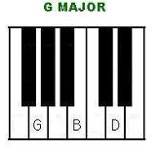
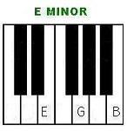
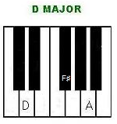



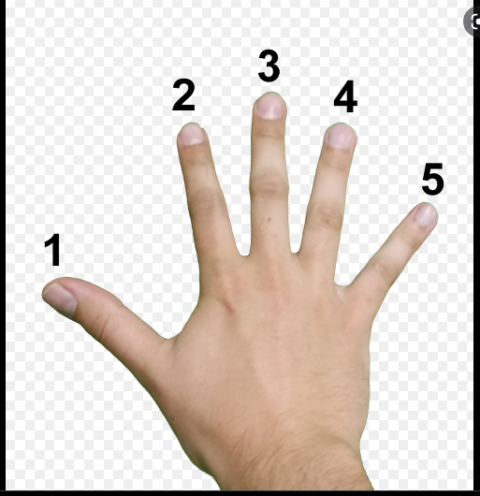
Music Year 8 Beautiful Girls
Key Knowledge
Key Skills
Key Vocabulary
Listening | Appraising | Performance | Composition
I can listen to a piece of music and understand the importance of being respectful to my fellow peers when performing. | I can appraise music using knowledge and understanding from the musical elements. | I can perform musically, fluently and accurately to the class. | I am able to compose a piece of music using musical devices and techniques.
Listen
Appraise
Perform
Compose
Sequence – A repeating pattern
Fluency- To perform smoothly without any hesitations
Chord – A series of notes played together
Dynamics – Loud and soft
Tempo – Fast and slow
Timbre – The instruments used
Pitch – High and low
Chord Progression – A succession of chords
Minor – Sad sounding
Bassline – the lowest part or sequence of notes in a piece of music
Melody – a sequence of single notes that is musically satisfying; a tune
Ostinato – Repeated musical idea
Keyboard Rules
*No writing on the keyboards!
*No banging on the keyboards!
*No use of demo’s unless instructed!
Key Terminology
Major, Ensemble, Solo, 4/4 , Chord, I, V, vi, IV

