Slide 1

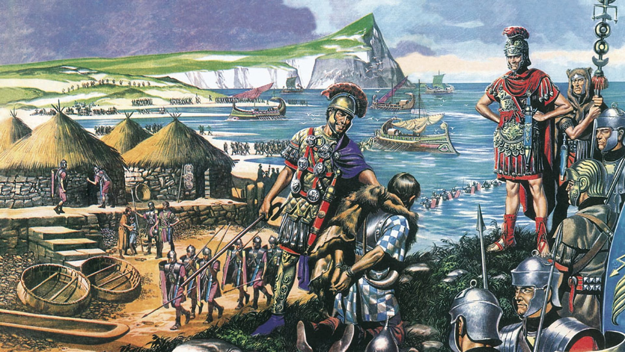
History - (Who were the English? Pre-1066) Year 7 Autumn 1
Key Knowledge
1. The first humans came to Britain from Africa thousands of years ago — one of the earliest people found is known as Cheddar Man. 2. Early people lived as hunter-gatherers, finding food and shelter from the land. 3. Farming (agriculture) changed how people lived — they began settling in villages and growing crops.. 4. The Romans invaded Britain in 43 CE. They brought roads, buildings, and new ways of life. 5. The Ivory Bangle Lady was a rich, mixed-race woman who lived in Roman York. Her grave shows that Roman Britain was diverse. 6. After the Romans left, the Anglo-Saxons arrived from Europe and created small kingdoms. 7. The Sutton Hoo burial shows us that Anglo-Saxons were skilled, wealthy, and had links with the wider world. 8. The Vikings came from Scandinavia to raid and later settle in Britain. They were warriors, but also farmers and craftsmen. 9. Viking society had its own laws, beliefs, and trade networks. 10. By 1066, Britain was a mix of people from many places — the English were already a blend of different cultures.
Timeline of Events
c.10,000 BCE | Cheddar Man lived in Britain.
c.4,000 BCE | Farming began in Britain.
43 CE | Romans invaded Britain.
c.250 CE | Ivory Bangle Lady lived in Roman York.
c.410 CE | Romans left Britain; Anglo-Saxons began to settle.
c.600 CE | Sutton Hoo burial took place.
793 CE | Vikings raided Lindisfarne — the start of Viking attacks in Britain.
c.866 CE | Vikings took control of York and large parts of northern England.
871–899 CE | Reign of Alfred the Great, a key Anglo-Saxon king.
1016 CE | King Cnut became Viking king of England.
Key Vocabulary
Hunter-gatherer | A person who finds food by hunting animals and collecting plants.
Agriculture | Farming – growing crops or raising animals for food.
Migration | When people move from one place to another to live.
Settlement | A place where people build homes and live together.
Empire | A group of countries or areas ruled by one leader or country.
Diversity | A mix of different people, backgrounds, or ideas.
Kingdom | A land ruled by a king or queen.
Barbarian | A word Romans used for people who didn’t share their way of life.
Civilised | Having advanced laws, government, buildings, or culture.
Craftsmen | Skilled workers who make things by hand, like tools or jewellery.
Warrior | A person trained to fight in battles or wars.
Key People
Cheddar Man | One of the oldest human remains found in Britain (around 10,000 years ago).
Ivory Bangle Lady | A rich woman from Roman York, likely of African and European descent.
Boudicca | A British tribal queen who led a revolt against the Romans.
Alfred the Great | An Anglo-Saxon king who defended England against Viking attacks.
King Cnut | A Viking king who ruled over England, Denmark, and Norway.

