Slide 1

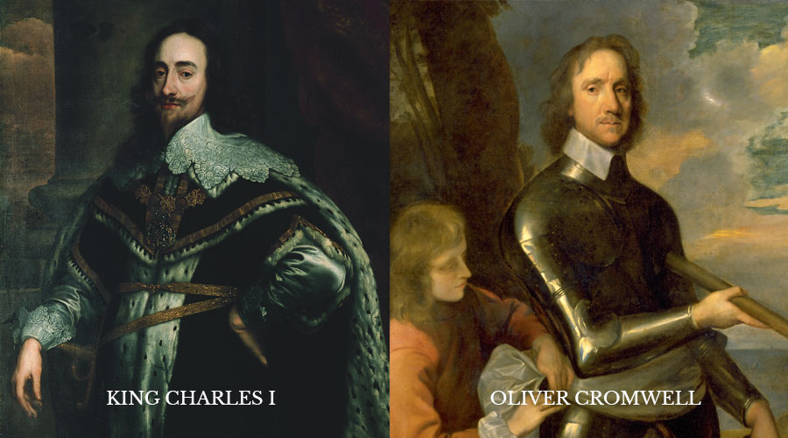
History - (Challenging Power 17th Century) Year 8 Autumn 1
Key Knowledge
1. The Gunpowder Plot (1605) was a failed plan by a group of Catholics to blow up King James I and Parliament. 2. Catholics were treated unfairly under King James I, which made some of them very angry. 3. The English Civil War (1642–1651) happened because King Charles I and Parliament argued over power, money, and religion. 4. The country split: some people supported the King (Royalists), others supported Parliament (Parliamentarians). 5. King Charles I was executed in 1649 after losing the war – the first time a king was put on trial and killed by his own people. 6. Oliver Cromwell took control of the country and ruled without a king. This time was called the Interregnum. 7. Cromwell was a strict Puritan. He banned fun things like dancing, theatre, and Christmas celebrations. 8. In 1660, Charles II became king again. This was called the Restoration. 9. In 1688, the Glorious Revolution happened – King James II was removed and replaced by William and Mary. 10. The Bill of Rights (1689) gave more power to Parliament and started a new system called constitutional monarchy, where the king or queen had to follow the law.
Timeline of Events (1605-1689)
1605 | Gunpowder Plot fails – Guy Fawkes arrested.
1625 | Charles I becomes king
1642 | English Civil War begins between King and Parliament.
1649 | King Charles I is executed – monarchy ends.
1653 | Oliver Cromwell becomes Lord Protector – rules without a king.
1658 | Oliver Cromwell dies
1660 | Restoration – Charles II becomes king.
1685 | James II becomes king – he is Catholic.
1688 | Glorious Revolution – James II removed, William and Mary invited to rule.
1689 | Bill of Rights signed – limits royal power and strengthens Parliament.
Key Vocabulary
Plot | A secret plan.
Gunpowder | Explosive material used in the 1605 Plot.
Treason | A crime against your own country or king.
Catholic | A branch of Christianity loyal to the Pope in Rome.
Protestant | A branch of Christianity that protested against the Catholic Church.
Puritan | A strict Protestant who wanted to purify the Church of England.
Restoration | The return of the monarchy in 1660.
Persecution | Cruel or unfair treatment, especially because of religion.
Extremists | People with strong, sometimes dangerous, beliefs.
Constitution | A set of rules about how a country is run.
Key People
Guy Fawkes | Catholic who tried to blow up Parliament in 1605.
King James I | Protestant king targeted by the Gunpowder Plot.
King Charles I | Believed he should have all the power – was executed in 1649.
Oliver Cromwell | Took control after the Civil War and ruled England.
King Charles II | Became king again in 1660 after Cromwell.
King James II | Catholic king who was removed in 1688.
William and Mary | Took over after James II – agreed to share power with Parliament.

