Slide 1


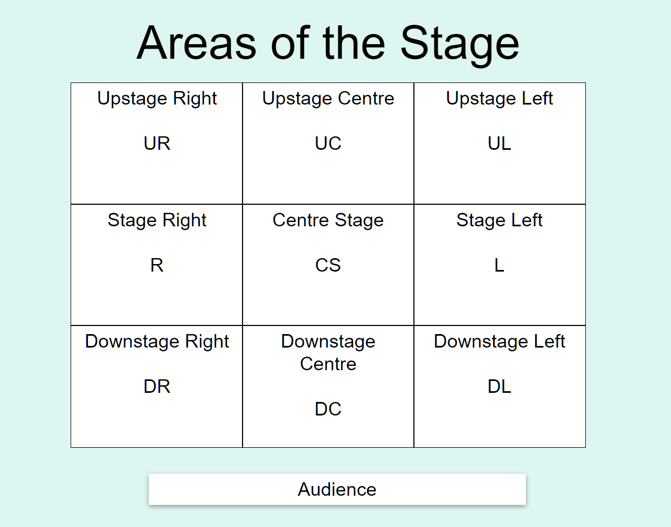
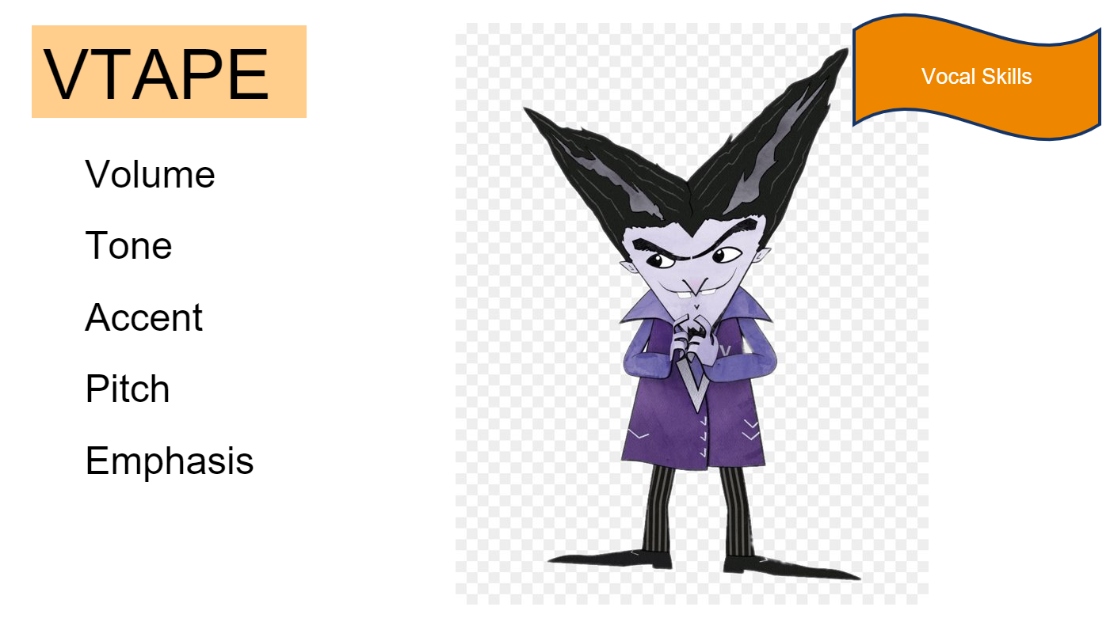
Year 8
Drama
Blood Brothers
"Blood Brothers" is a musical by Willy Russell about twin brothers, Mickey and Eddie, who get separated when they're born. They grow up in different families and become friends without knowing they're actually brothers. They have different lives because of money and where they live. They both like the same girl, which makes things complicated. The story shows how things like money and where you grow up can change your life. It has a sad ending that teaches us about secrets and how society can affect us. "Blood Brothers" makes us think about how our lives are shaped and the importance of family.
Key words
Social Class - Social class is like different groups of people in society. It's based on things like how much money someone has, what job they do, and their background. It can affect how people are treated and the opportunities they have. Status - Status is about how important or respected someone is compared to others. It can depend on things like how much money they have, what job they do, or how people see them. Status can affect how people act and how they treat each other. Ensemble - Ensemble means a group of people working together in a play or show. They all have important parts, and no one person is more important than the others. It's like a team effort where everyone contributes to make the story happen. Atmosphere - Atmosphere is the feeling or mood in a play or show. It's created by things like how the characters talk, the place they're in, the lights, music, and how the actors perform. Atmosphere helps us understand the emotions and vibe of the story. Multi-role - Multi-role means when an actor plays more than one character in a play or show. They change their appearance and act differently to become different people. It makes the story more interesting and shows the actor's talent in playing different roles. Cyclical plot - A cyclical plot refers to a narrative structure in which the events or themes of a story repeat or return in a circular pattern. In this type of plot, the story begins and ends in a similar or identical manner, creating a sense of continuity and closure. The cyclical nature of the plot often emphasizes the idea of recurring patterns or cycles in life.

