Slide 1

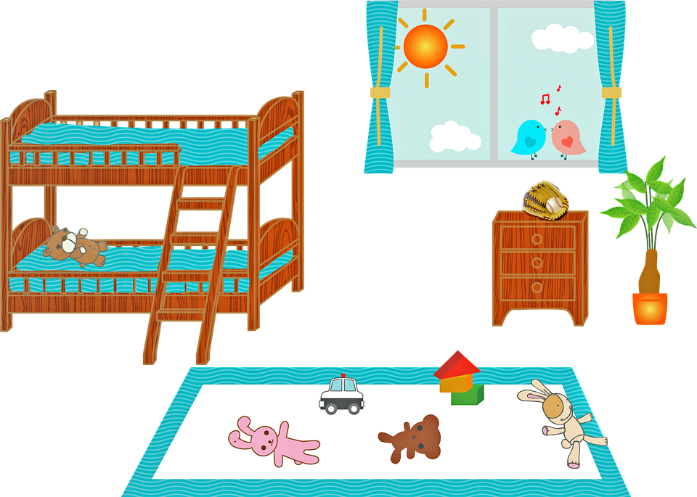
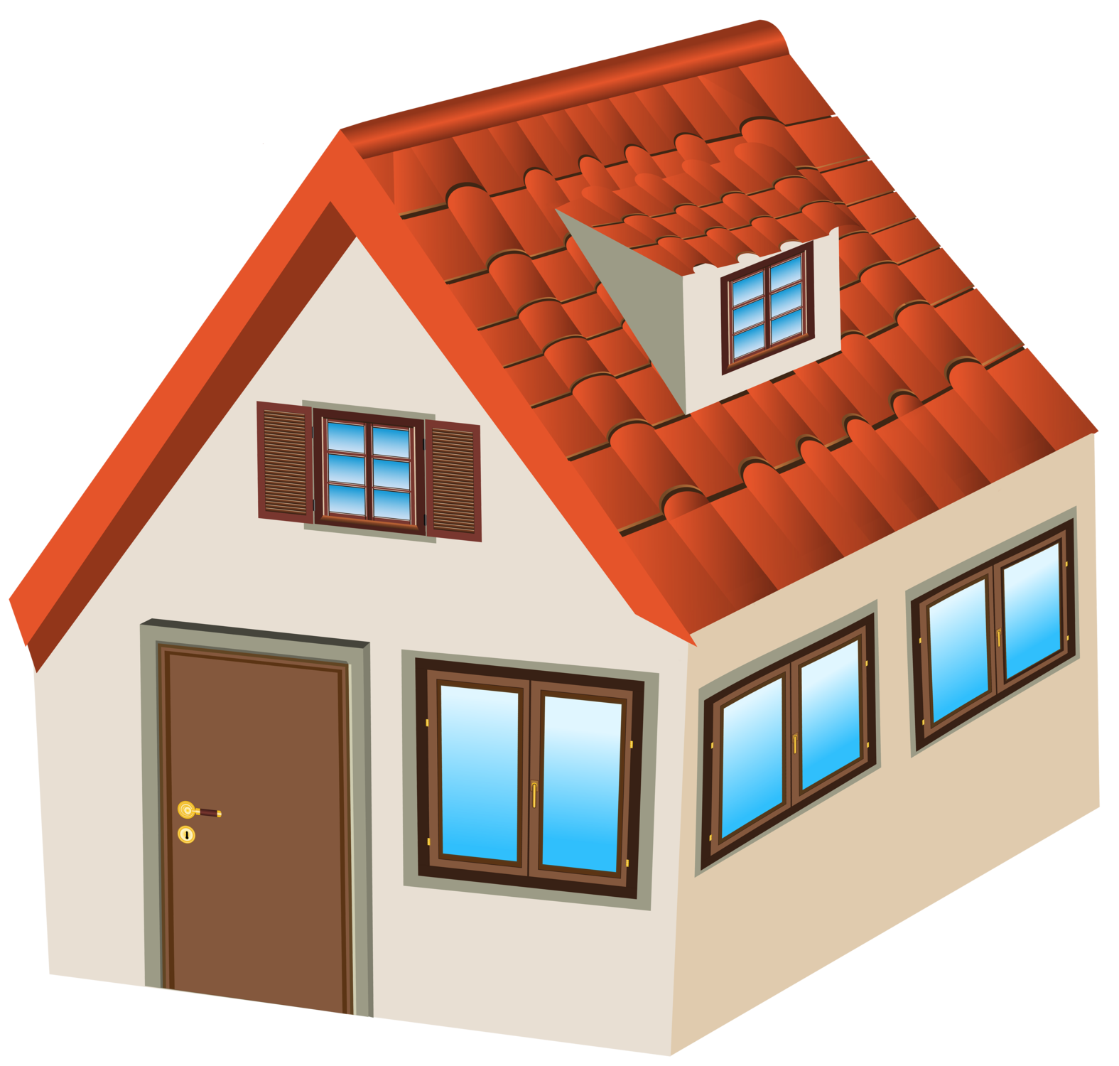
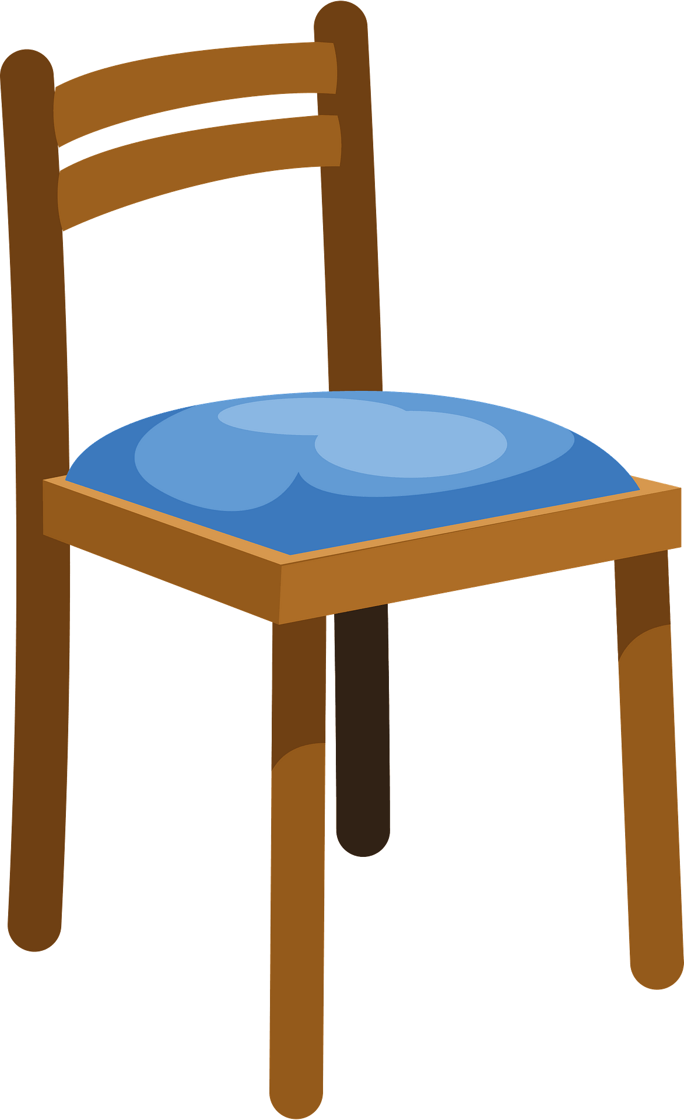
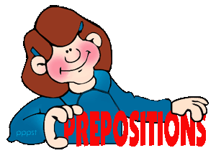
Year 8 Spanish Unit 1: House &Homelife Knowledge Organiser
Big questions
Dow do you say Where is my house?
How do I describe my house?
How do I say what furniture my have?
Where is everything?
How do I describe my ideal room?
How do I say what I did yesterday?
Ways to practise vocabulary: 1. Look cover, write check 2. Log onto Quizlet 3. Getting people at home to test you 4. Language Nut
Key vocabulary
las habitaciones – rooms
en mi casa | in my house
hay | there is
en la planta baja | on the ground floor
en la primera planta | on the first floor
en el sótano | in the basement
un salón | a living room
un desván | a loft
un jardín | a garden
un despacho | an office
un cuato de estar | a living room
un cuarto de baño | a bathroom
un comedor | a dining room
un dormitorio | a bedroom
el dormitorio de mi hermana | my sister’s bedroom
Describing where we live
vivo/vivimos | I live /we live
en una ciudad/un pueblo | In a town /village
en el campo | in the countryside
en las montañas | in the mountains
en la costa | at the seaside
en una casa adosada | In a semi-detached house
en una casa grande | In a big house
en una casa pequeña | In a small house
en un piso | a flat
en una granja | a farm
los muebles Furniture
en mi casa | in…
hay/no hay | there is/are/isn’t/aren’t
(un) sofá | a sofa
(un) horno | an oven
(un) baño | a bath
(un) lavabo | a wash basin
(una) moqueta | a rug
(una) nevera | a fridge
(una) butaca | an armchair
(un) microondas | a microwave
(un) aseo | a toilet
(una) silla | a chair
(una) estantería | a bookshelf
(una) cama | a bed
(un) armario | a wardrobe
(una) mesa de noche | a bedside table
(unas) cortinas | curtains
Adjectives
mi casa/piso es | My house/ flat is
grande | big
pequeño/a | small
sucio/a | dirty
limpio/a | clean
moderno/a | modern
bonito/a | pretty
histórico/a | historical
cómodo/a | comfortable
incomodo/a | uncomfortable
feo/a | ugly
Prepositions
encima | on top
debajo de | underneath
delante de | in front of
detrás de | behind
al lado de | next to
a la izquierda/derecha | to the right/left
los pasatiempos
publiqué | I posted
ví | I watched
navegué | I surfed
Descargué | I downloaded
Intensifiers
bastante - quite
un poco—a little
los pasatiempos – hobbies
chatée | I chatted
escuché | I listened
mandé | I sent
jugué | I played

Slide 2
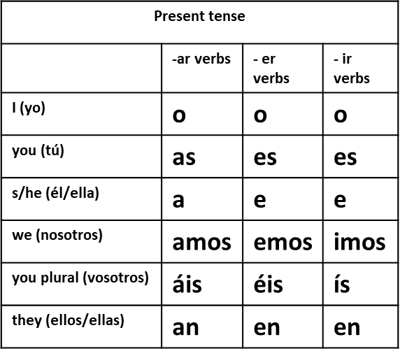
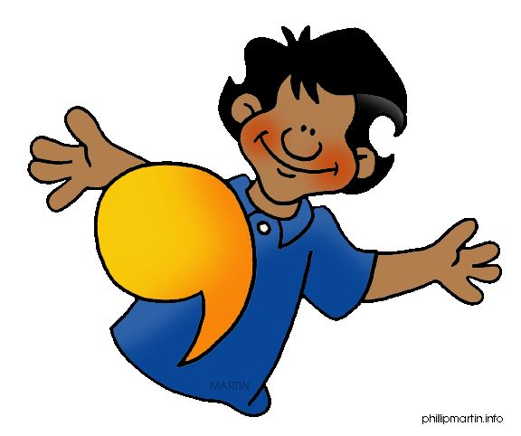
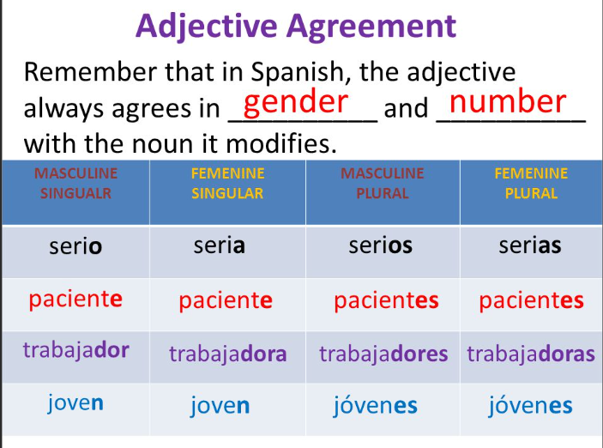
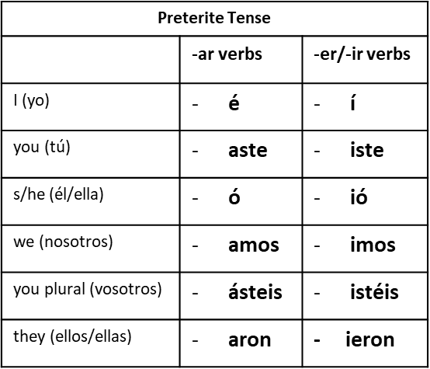
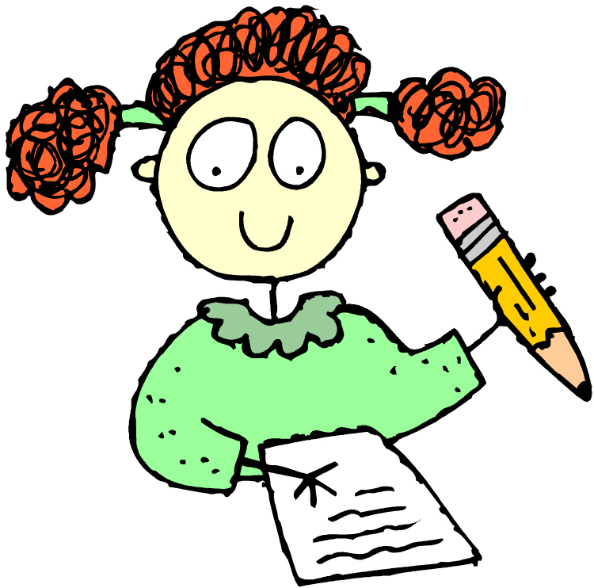

Useful Grammar
The indefinite article
The indefinite article means a/an in English.
In Spanish they are un (masculine) and una (feminine)
Example: en mi casa hay una cocina y un salón
The present tense
To form the present tense
Take the infinitive (-ar/er/ir)
Take off the ending
Add the following endings depending on who is doing the verb
Negatives no – not
To form a negative in Spanish, we simply put “no” in front of the main verb.
You do not need un/una after a negative!
No hay piscina
Adjectives and adjective agreement
Adjectives agree with the gender and number of the noun they describe.
Adjectives usually go after the noun
For example: tengo una cocina moderna y pequeña
Adjectives which don’t follow the rules!
Some adjectives do not follow the –o/-a rule
Example: adjectives ending in…
e
or
en
consonants
Sometimes you have to add another letter
The preterite tense (past tense)
To form the present tense
Take the infinitive
Take off the endings (-ar/-er/-ir)
Add the appropriate endings
Past time phrases
ayer | Yesterday
La semana pasada | Last week
Verbs which end in –gar/-car
In the past tense the I form changes in order to keep pronunciation rules.
Therefore – navegar becomes navegué
Descargar becomes descargue

