Slide 1


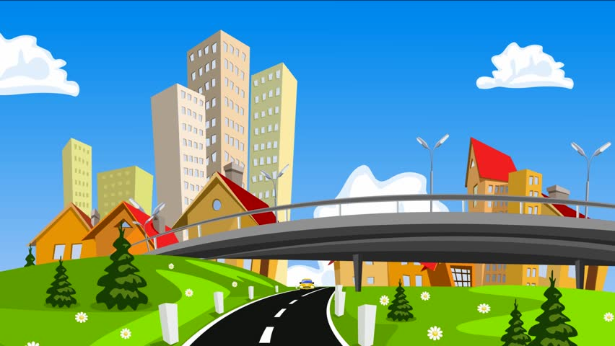

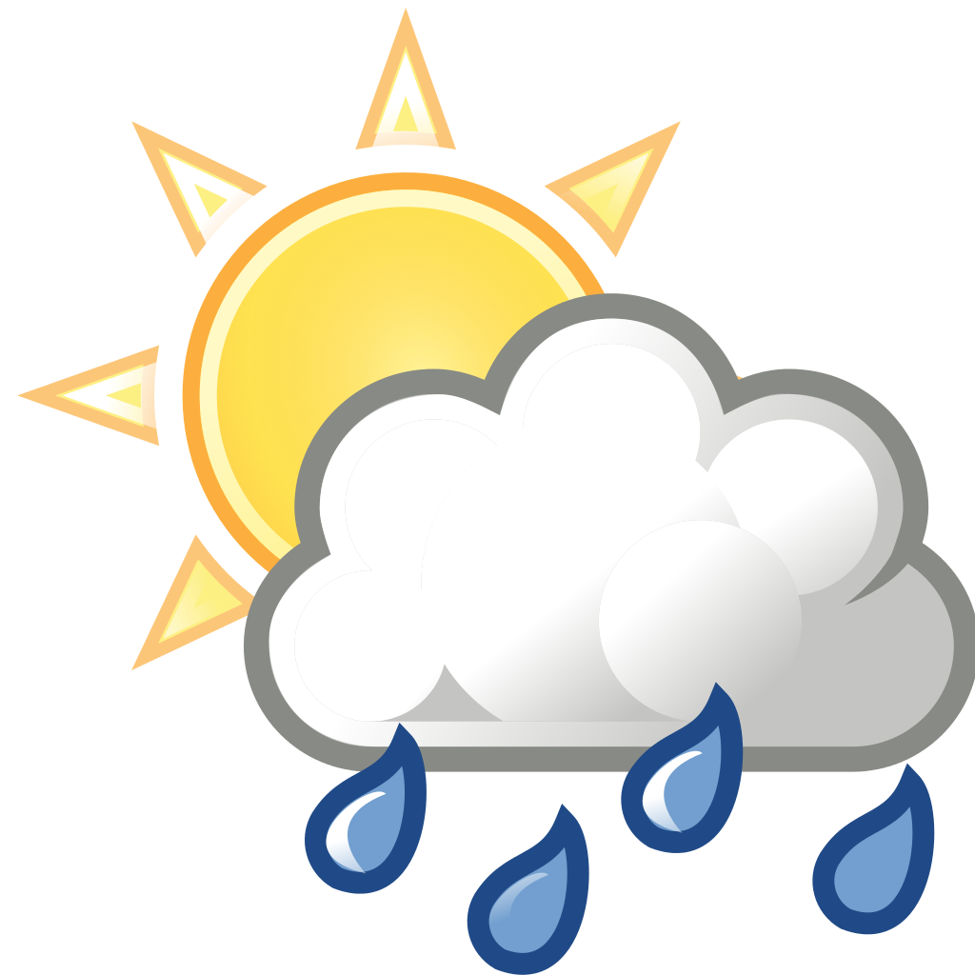

Year 8 Spanish Unit 2: Hometown Knowledge Organiser
Big questions
How do describe places in the town?
How do I ask direction in Spanish?
How do I talk about the weather in Spanish?
How do I talk about what I visited in Spanish?
How do I describe my ideal town in Spanish?
Ways to practise vocabulary: 1. Look cover, write check 2. Log onto Language Nut 3. Getting people at home to test you 4. Quizlet
Key vocabulary
Adjectives
mi ciudad/mi pueblo es | my town/my village is
malo/a | rubbish
rural | rural
ruidoso/a | noisy
viejo/a | old
antiguo/a | old
horrible | awful
Describing where we live
vivo | I live
en | in
el norte | the north
el sur | the south
el este | the east
el oeste | the west
el centro | the centre/midi
el noreste/suroeste | the north West/South west
en Inglaterra | in England
en Escocia | in Scotland
en Alemania | in Germany
en Gales | in Wales
las indicaciones – directions
siga todo recto | go straight on
dobla a la izquierda | turn left
dobla a la derecha | turn right
toma la primera a la izquierda | take the first street on the left
toma la segunda a la derecha | take the second street on the right
cruza el puente | cross the bridge
continua a los semáforos | go to the traffic light
a la rotonda | at the roundabout
continua | continue
el tiempo—weather
en mi ciudad | in my town
hace sol | it is sunny
hace viento | it is windy
hay tormenta | it is stormy
está nublado | it is cloudy
hace buen tiempo | it is nice weather
hace mal tiempo | it is nasty weather
hay niebla | it is foggy
llueve | it is raining
nieva | it is snowing
en la ciudad—in the town
hay | There is/are
la pista de heilo | the ice rink
la piscina | the swimming pool
es estadio | the stadium
la discoteca | the disco
el puerto | the port
el bosque | the forest
el ayuntamiento | the town hall
la estación de autobuses | the bus station
la comisaría | the police station
la estación de trenes | the train station
la iglesia | the church
Ordinal numbers
primero/a | first
segundo/a | second
tercero/a | third
quarto/a | fourth
quinto/a | fifth
si… if…
Si | if
si hace buen tiempo | if it is nice
si llueve | if it is raining
voy a ir al parque | I’m going to the park
voy a ir al cine | I’m going to go to the cinema
Intensifiers
muy – very
demasiado – too
bastante – quite
un poco – a little

Slide 2
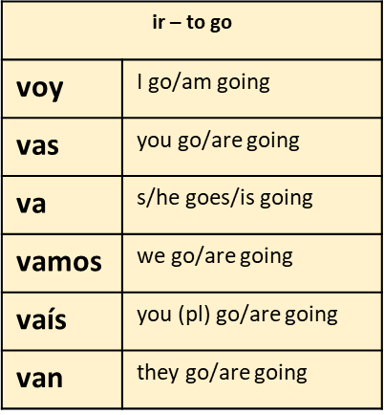
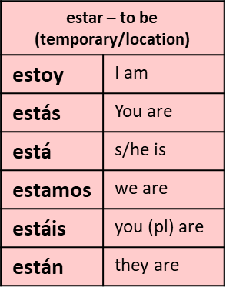
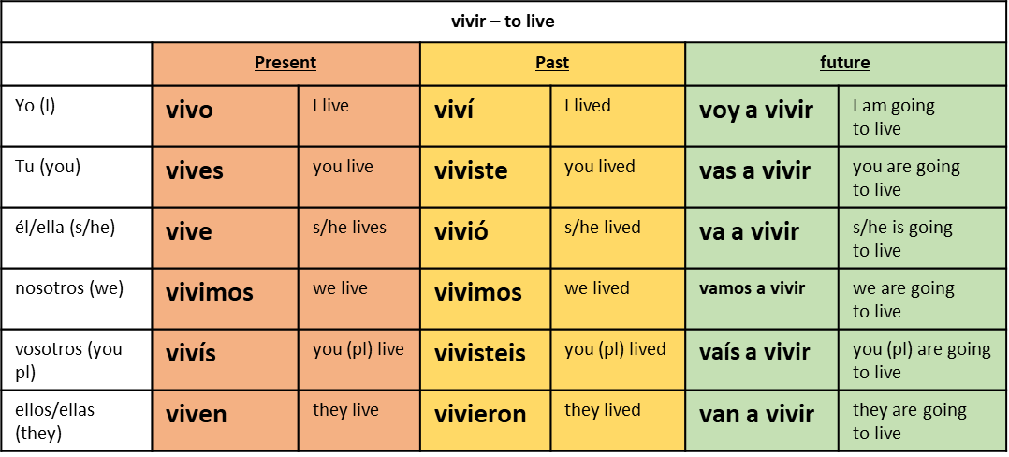
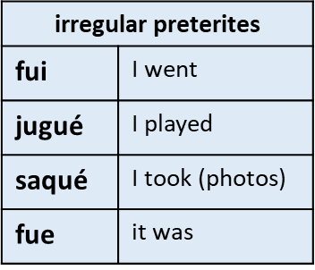
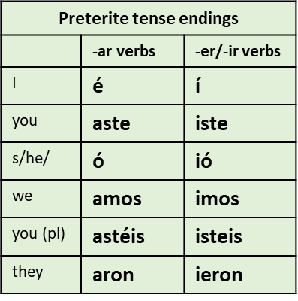
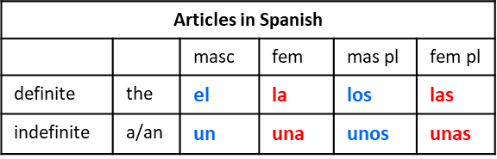
Key verbs
Tricky pronunciation:
izquierda | ee-th-key-air-dah
plaza | platha
jugué | who-geh
Useful Grammar
Adjectival agreement
When you are describing things or people you must agree the adjective to them. If an adjective ends in a o and you are describing a feminine noun, you change to o to an ‘e’.
Other endings do not change UNLESS you are discussing more than one person, then you will need to add an ‘s’ in most cases.
example: una granja moderna unas granjas modernas
Key Questions
¿dónde vives? | where do you live?
¿Qué hiciste en tu región la semana pasada? | what did you do in town last weekend?
¿Cómo sería tu ciudad perfecta? | what would your ideal town be like?
¿dónde está/están? | where is/are?
The preterite tense in Spanish
To form the preterite tense in Spanish we need:
The infinitive of the main verb
Take off the infinitive ending
Add the appropriate past tense ending:
Definite and indefinite articles.
Definite articles mean THE in English.
Indefinite articles mean A/AN in English

