Slide 1


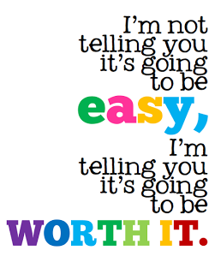

Y11 GCSE Success Evening 2025
Pride
Endeavour
Resilience
Kindness
#Transforming lives

Slide 2
Understanding the Year Ahead
Pride  Endeavour  Resilience  Kindness

Slide 3
Sunset Sessions Start Monday 13th October
Pride
Endeavour
Resilience
Kindness
Mock Exams Start Monday 17th November (2 weeks and 1day)
11th December Y11 Parents Evening
Turbo Week w/b 15th December
January BTEC Sport External Exam (8/1/26) and Drama Assessment (Date TBC)
Mock Exams 2 Monday 9th February 2026
GCSE Exams Start 1st May 2026

Slide 4
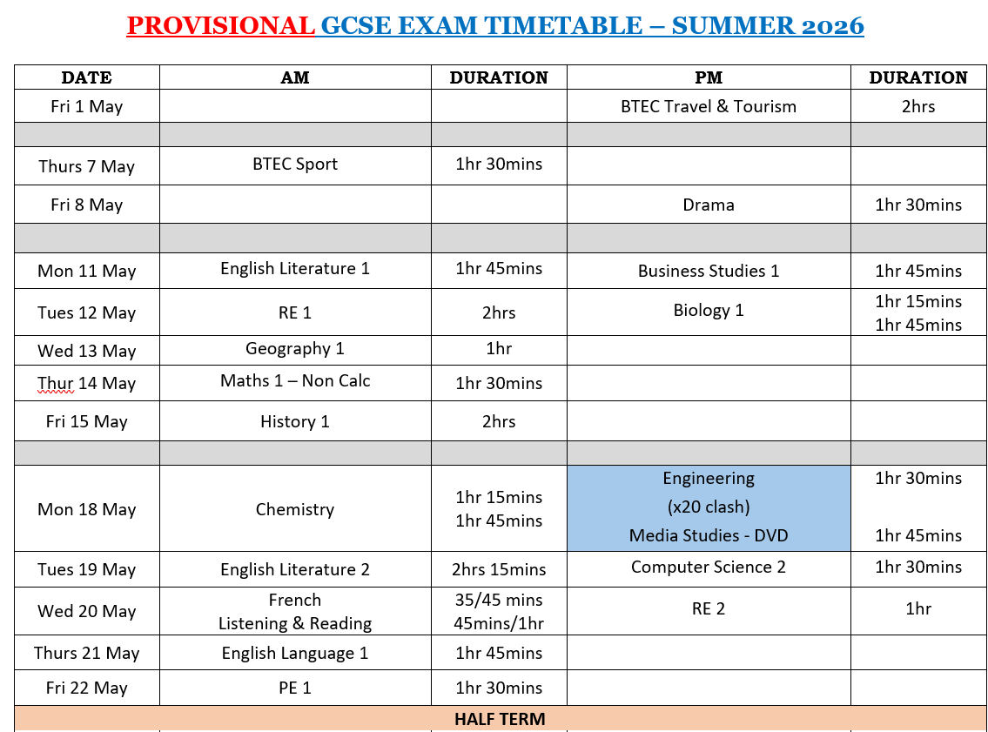
Pride  Endeavour  Resilience  Kindness

Slide 5
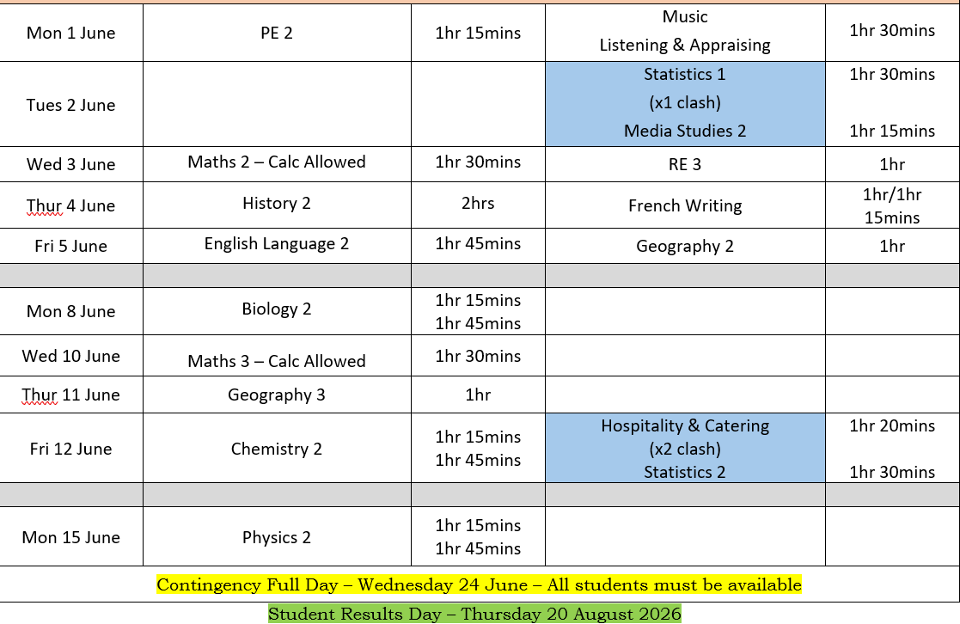
Pride  Endeavour  Resilience  Kindness

Slide 6
Why are GCSE’s important?
College
6th Form
Apprenticeships
Vocational courses
Pride  Endeavour  Resilience  Kindness

Slide 7
What it will take
Consistency over time, not just bursts of effort.
01
Supporting one another, not competing with one another.
02
Taking responsibility for your learning, behaviour, and future.
03
Pride  Endeavour  Resilience  Kindness

Slide 8
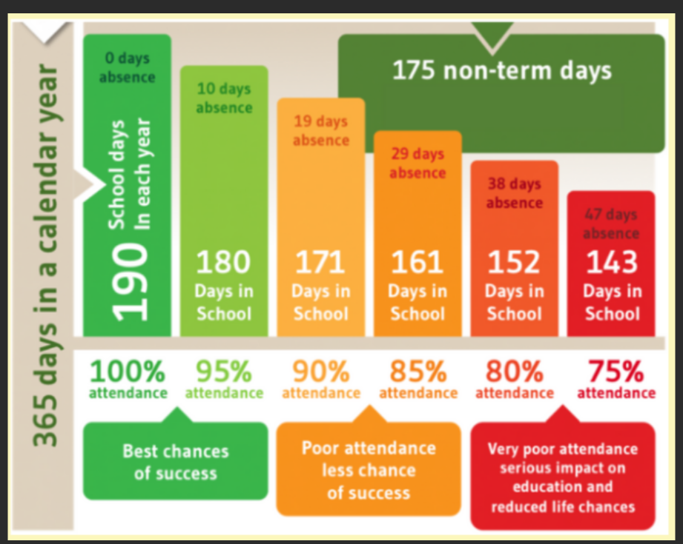
Attendance
Pride  Endeavour  Resilience  Kindness

Slide 9
Support available within school
Pastoral support
Pride  Endeavour  Resilience  Kindness

Slide 10
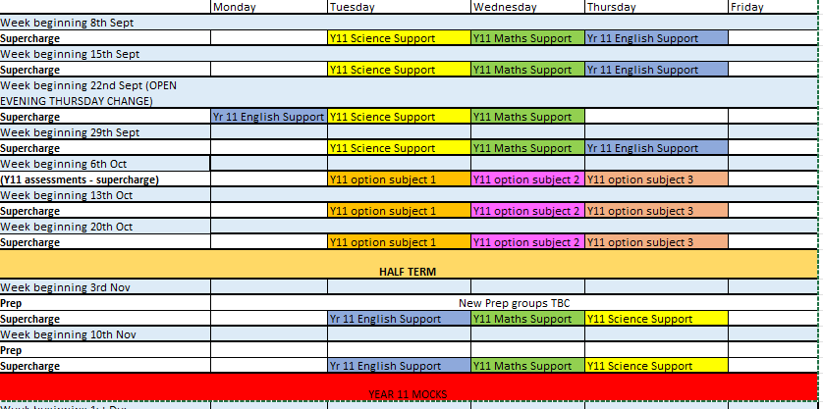
How we are going to support you:
1. Supercharge

Slide 11
2. Prep small group
The groups will change after half term
You have 7 weeks of this support so make it count!
Those remaining in prep lessons will have a combination of careers, study skills support etc

Slide 12
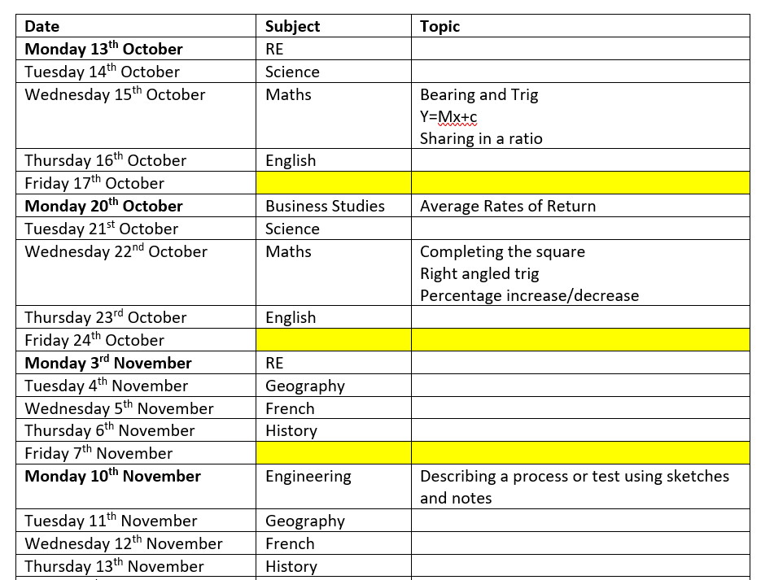
How we are going to support you:
3. Sunset Sessions
Expectations:
They will be set on Teams as an assignment at 8pm every evening.
Participation is rewarded!

Slide 13
4. Form tutor mentoring
5. Seneca Catch up Groups to support you when you have missed lesson time
6. Study resources – Mock Exam Handbook
7. SEND Support
Pride  Endeavour  Resilience  Kindness

Slide 14
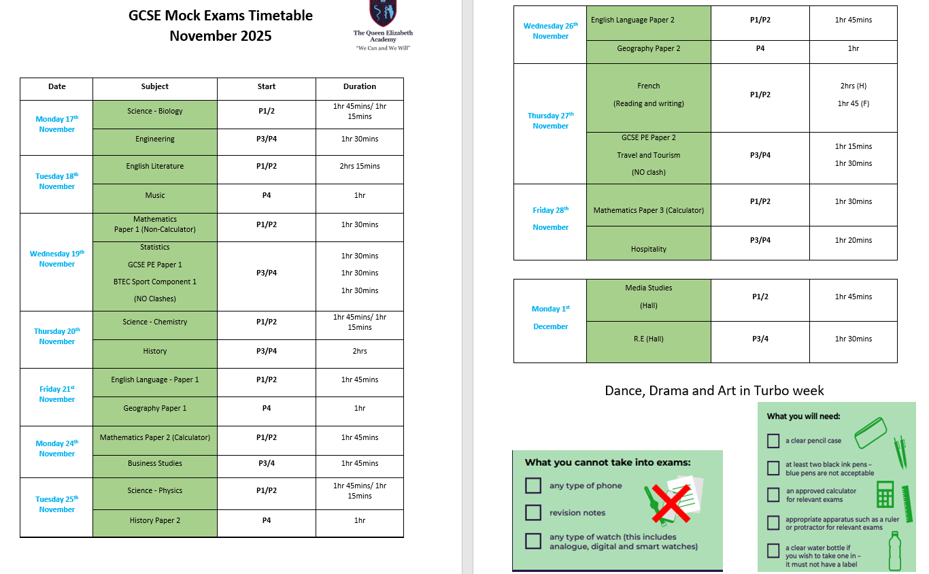
Resources – Mock Exam Handbook
Pride  Endeavour  Resilience  Kindness

Slide 15
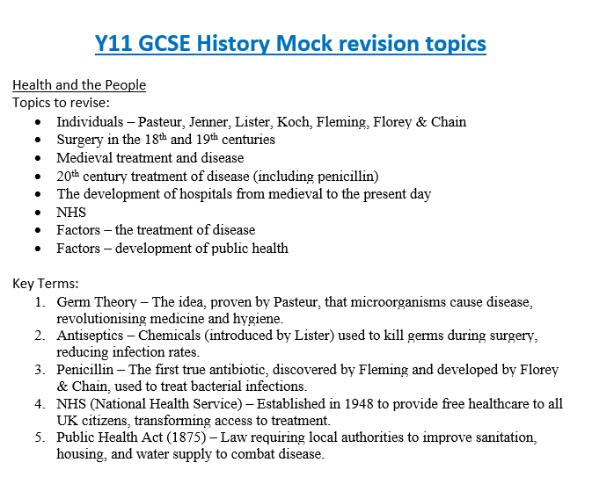
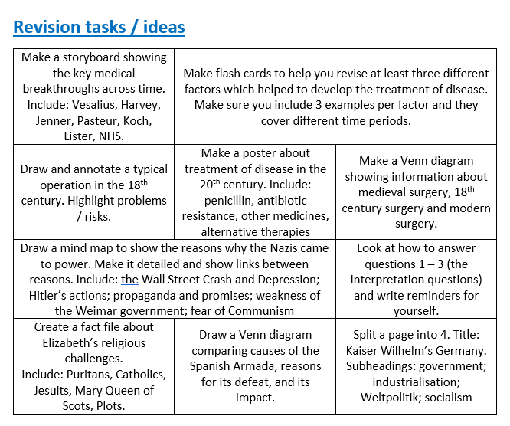
Resources – Mock Exam Handbook
Pride  Endeavour  Resilience  Kindness

Slide 16
What should you being doing at home?
Pride  Endeavour  Resilience  Kindness
#Transforming lives

Slide 17
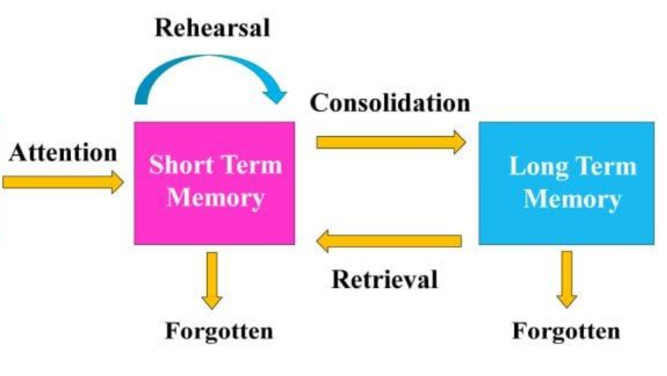
Revision is key
Pride  Endeavour  Resilience  Kindness
#Transforming lives

Slide 18
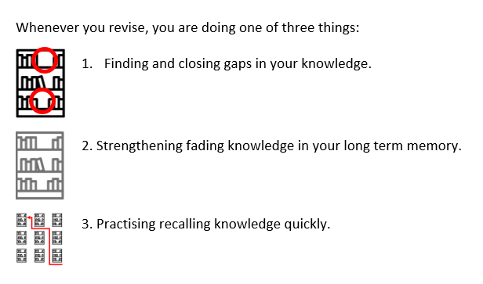
Pride  Endeavour  Resilience  Kindness
#Transforming lives

Slide 19
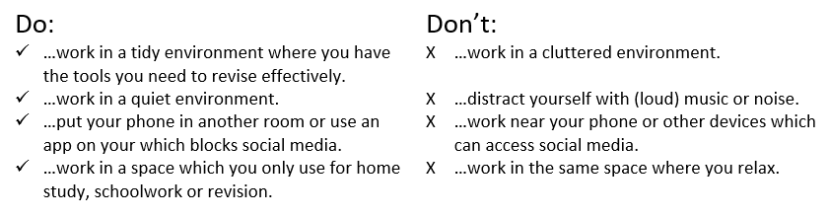
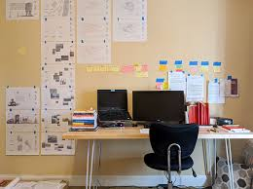
Create a space to revise
Pride  Endeavour  Resilience  Kindness
#Transforming lives

Slide 20
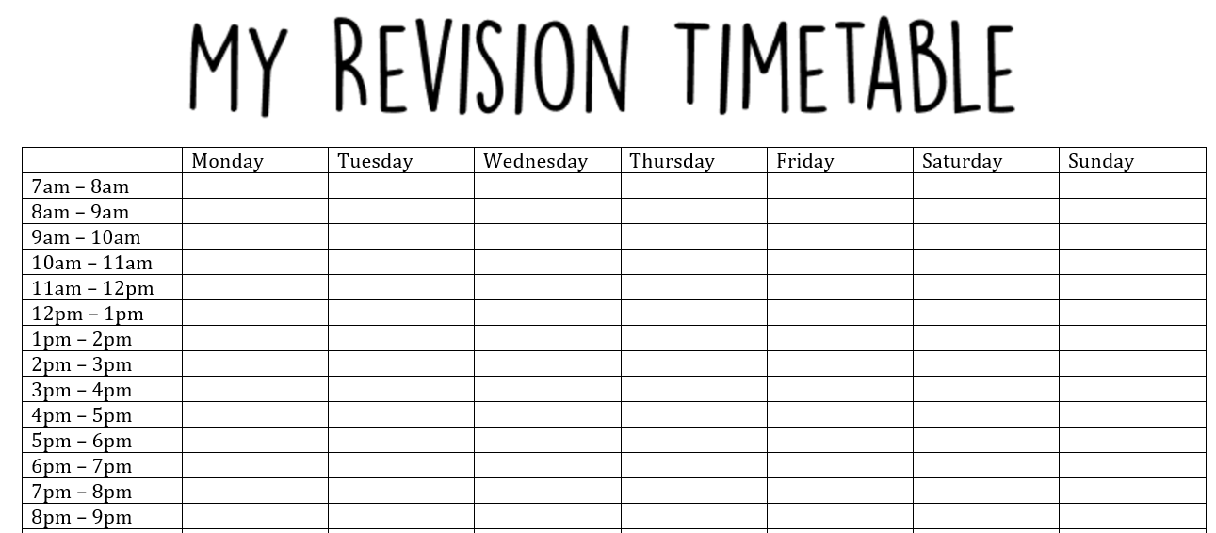
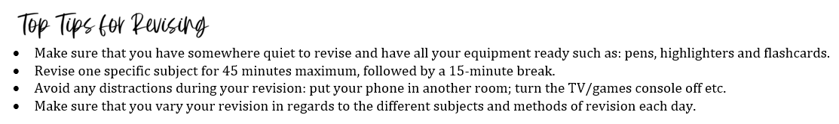
Pride  Endeavour  Resilience  Kindness
#Transforming lives

Slide 21
Revision Strategies that work
Spaced retrieval vs cramming
Active Revision techniques:
Flashcards (Leitner system)
Self Quizzing
Blurting
Past Paper Practice
Teaching someone else
Pride  Endeavour  Resilience  Kindness
#Transforming lives

Slide 22
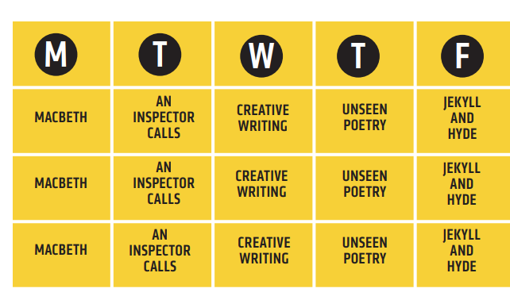
Interleaving

Slide 23
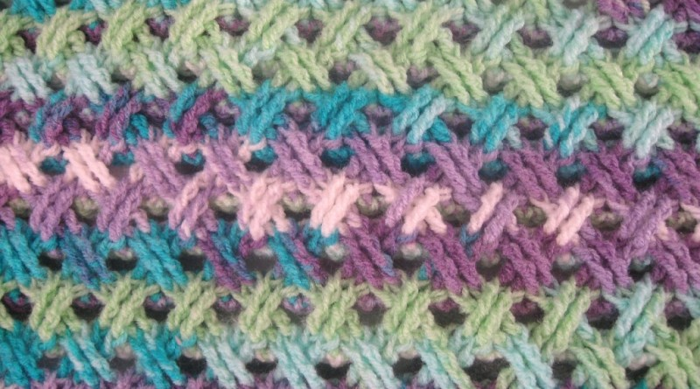
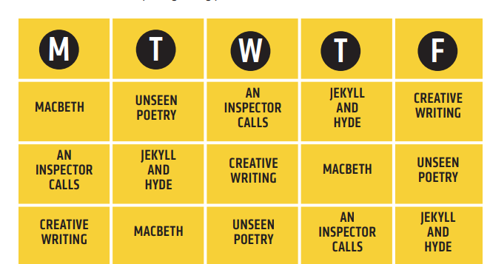
Interleaving

Slide 24
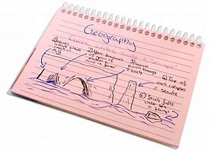
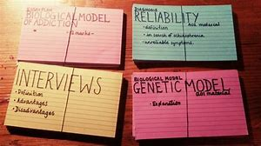
Flashcards
Flashcards are a useful method of revision
Before you can start using flashcards you need to create them
On the one side write a question and on the back write the answers or draw a diagram
At a very simple level you can use the cards to test yourself or ask someone else to test you using the flashcards
Pride  Endeavour  Resilience  Kindness
#Transforming lives

Slide 25
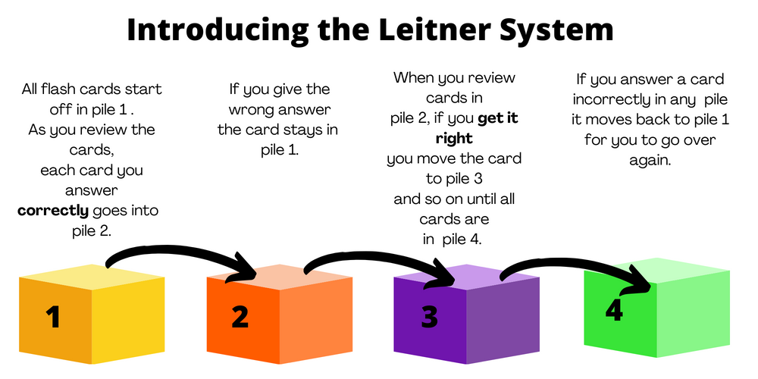
Pride  Endeavour  Resilience  Kindness
#Transforming lives

Slide 26
How can parents/carers support at home?
Create routines and a quiet study space
Monitor wellbeing and sleep
Ask questions (use flashcards with them)
Help stick to revision timetables
Keep communication open without pressure
Pride  Endeavour  Resilience  Kindness

Slide 27

GCSE Results Day. What will it look like when you reach the peak?
Exams begin
Evaluate your progress. What interventions do you need to help you make that final push to the summit?
Mock exams - Evaluate your progress. What do you need to help you succeed?
What is your current position? How are you going to move forwards?
Pride  Endeavour  Resilience  Kindness

